Slide 1
Real-time Diagnostic Tools for the Scanning Electron Microscope
Liuchuyao Xu, 2020

Slide 2
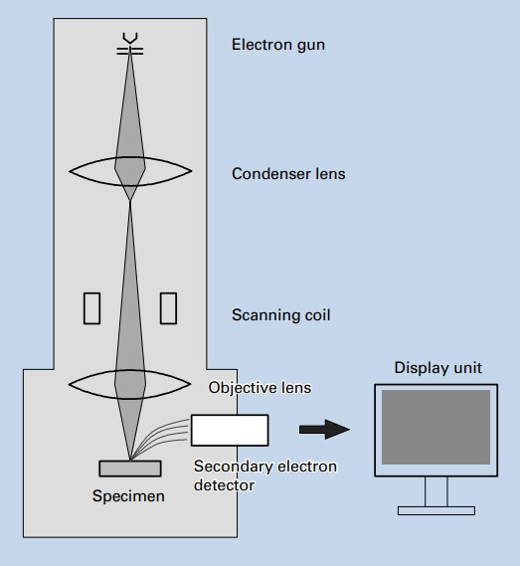
Scanning electron microscope (SEM)

Slide 3
Main features of the software
Histogram calculation
Fast Fourier transform (FFT) calculation
~10 frames per second

Slide 4
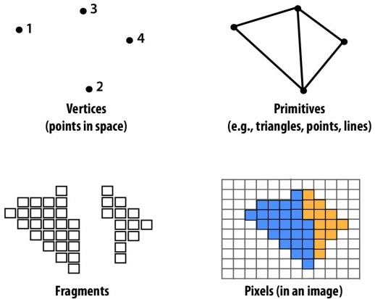
Parallelism in GPU architecture

Slide 5
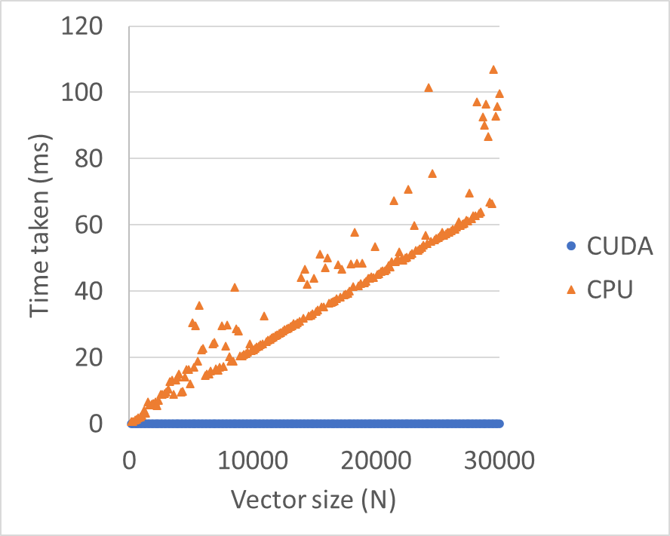
Performance test

Slide 6
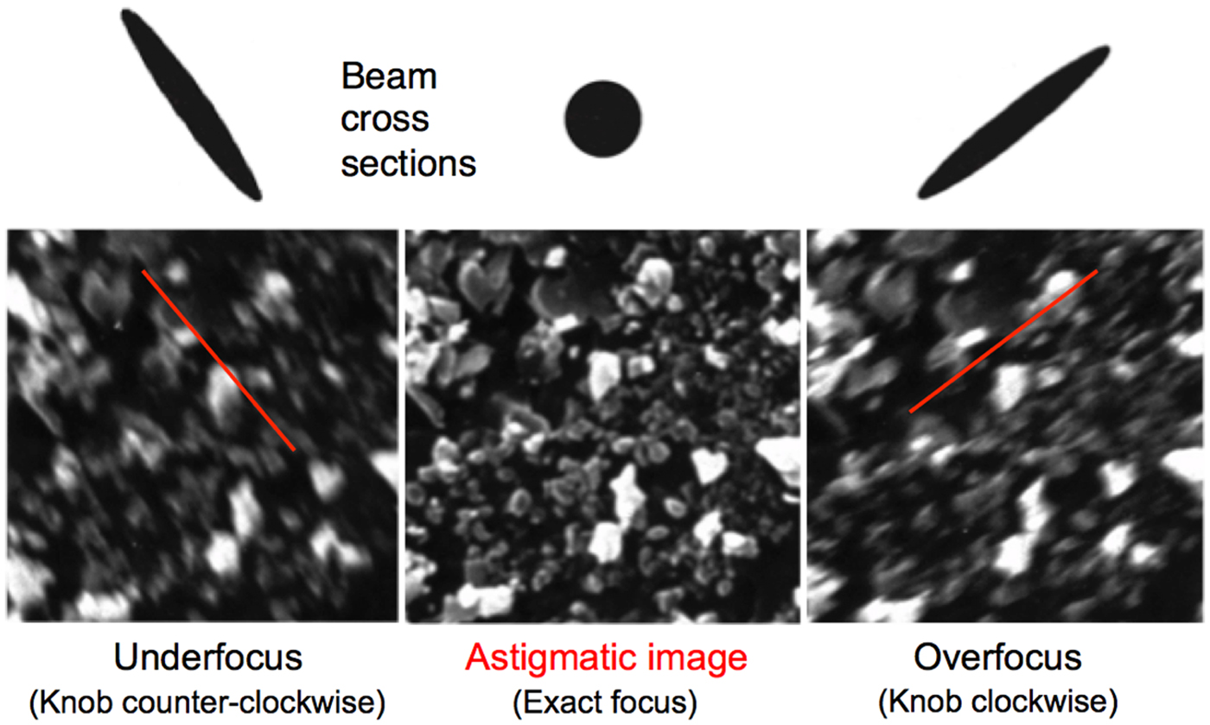
Astigmatism

Slide 7
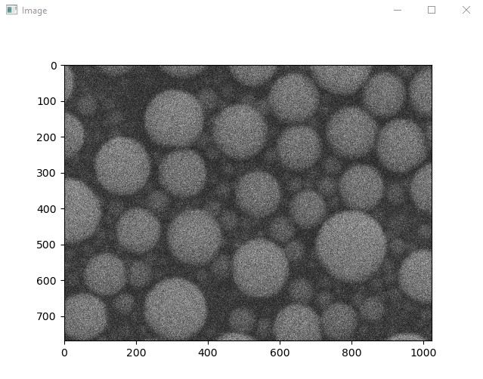
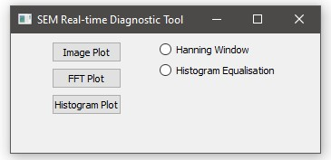
Demonstration of the software

Slide 8
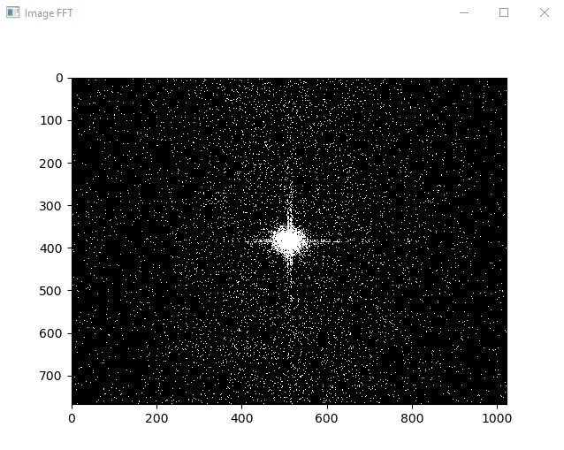
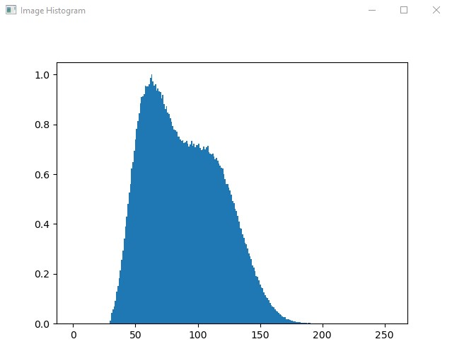
Demonstration of the software

Slide 9
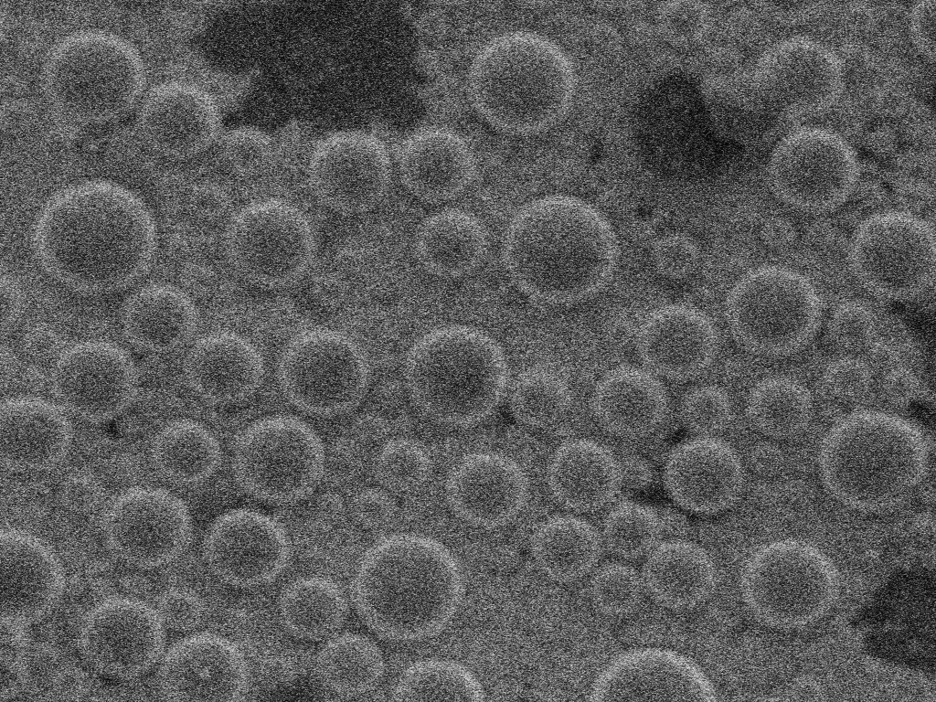
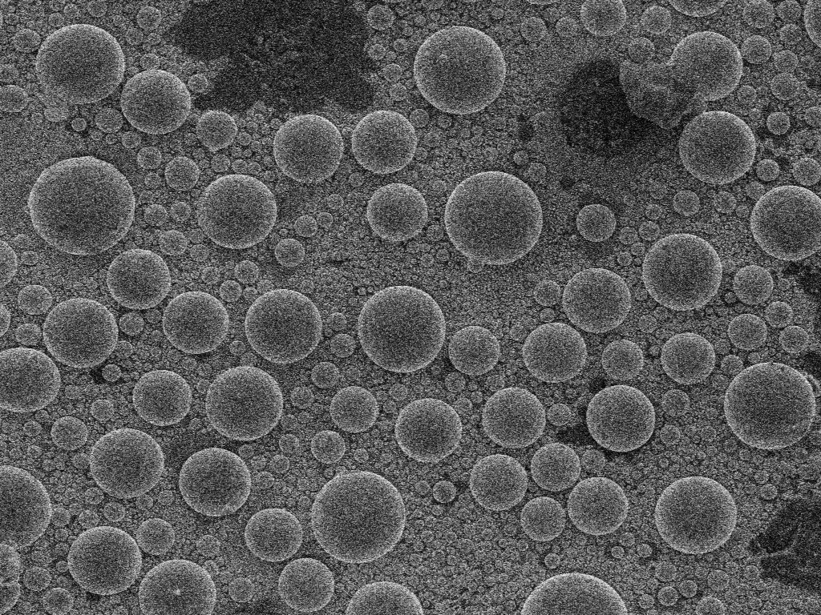
Focusing and astigmatism correction algorithm

Slide 10
Thank you.

